Slide 1
ATTITUDES AND JOB SATISFACTION

Slide 2
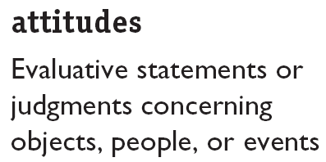
Attitude
They reflect how we feel about something

Slide 3
neutral objects questionnaire
HOW SATISFIED ARE YOU?
city in which you live satisfied neutral dissatisfied
neighbours you have satisfied neutral dissatisfied
high school you attended satisfied neutral dissatisfied
Climate where you live satisfied neutral dissatisfied
movies produced today satisfied neutral dissatisfied
quality of food you buy satisfied neutral dissatisfied
cars today satisfied neutral dissatisfied
local newspaper satisfied neutral dissatisfied
your first name satisfied neutral dissatisfied
people you know satisfied neutral dissatisfied
telephone service satisfied neutral dissatisfied
8 ½' x 11' paper satisfied neutral dissatisfied
restaurant food satisfied neutral dissatisfied
modern art satisfied neutral dissatisfied

Slide 4
What will we be talking about?
Main Components of attitudes
How consistent are attitudes?
Does behaviour follow attitudes?
What are the major job attitudes?
How are employee job attitudes measured?
Importance of attitudes to workplace diversity

Slide 5
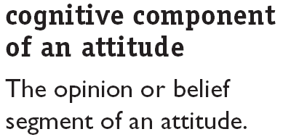
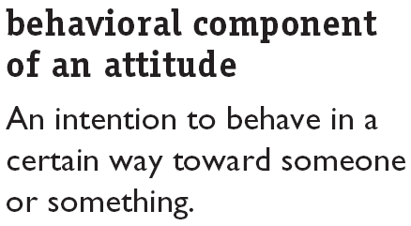
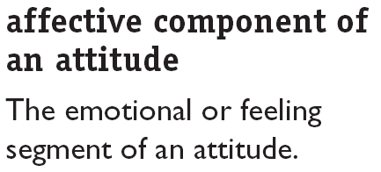
Components of attitude

Slide 6
Components of attitude
Cognitive = evaluation
My boss promoted X who deserved it less than me
Negative attitude towards boss
Affective = feeling
I dislike my boss
Behavioural = action
I’m looking for a new job
I’ve complained to anyone who will listen

Slide 7
How consistent are attitudes?
People usually change what they say so it doesn’t contradict what they do
Fox and the grapes
People seek for consistency between their attitudes and their behaviour ….Why?
To appear to be rational and consistent
So whenever inconsistency occurs, people try to bring about equilibrium by either changing their behaviour or their attitude OR Rationalise/ justify the discrepancy
E.g. arms manufacturer, tobacco, etc..

Slide 8
Cognitive Dissonance – Leon Festinger (1950s)
Cognitive dissonance :Any form of inconsistency is uncomfortable and individuals will try to reduce this dissonance.
  How do people cope OR Reduce Dissonance?
    Depending on the importance of the dissonant element
    Degree of influence individual has over this element
    Reward involved in the reduction of dissonance
Implication: People with dissonance may not necessarily move towards reducing the inconsistency

Slide 9
Does behaviour follow from attitudes?
Early research assumed….that attitudes people have, determine what they do…
Common sense and logic also seems to suggest such a relationship.
Late 1960’s this assumption was challenged, based on a number of researches…..
attitudes are slightly related to behaviour!
However, recent researches have shown that Attitudes predicts behaviour

Slide 10

Attitude-Behavior Relationship
Recent research indicates that the attitudes (A) significantly predict behaviors (B) when moderating variables are taken into account.
Moderating Variables
Behavioral Influence
Importance (e.g. self interest, identification with others)‏
Specificity (Stay on=satisfaction, < TO)‏
Accessibility (easily remembered – the more we talk about a subject, the more it can shape our behaviour)‏
Social pressures
Direct experience (no experience = not knowing how to react)‏
High
Low

Slide 11
Major Job Attitudes
Job Satisfaction
Job Involvement
Organizational Commitment
job satisfaction
Job satisfaction refers to an individual’s general attitude toward his or her job.
A person with a high level of job satisfaction holds positive attitudes toward the job, while a person who is dissatisfied with his or her job holds negative attitudes about the job.

Slide 12
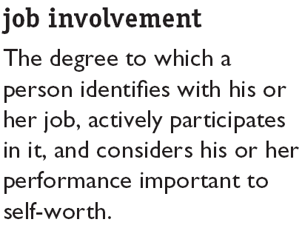
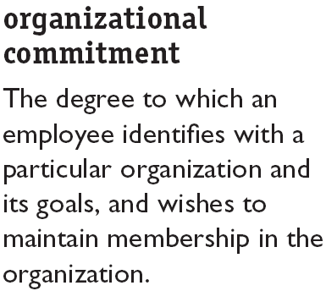


Major Job Attitudes

Slide 13
Implications for managers
Attitudes do give warnings of future behaviour.
Satisfied and committed employees have lower turnover rates, absenteeism, withdrawal behaviour…they perform better!
In a nutshell…Managers need to have some ways by which to measure major job attitudes.

Slide 14
Job Satisfaction
How do we measure job satisfaction?
What causes an employee to have a higher level of job satisfaction than another?
How satisfied are employees on the job?
How does satisfaction /dissatisfaction affect the organisation?

Slide 15
Measuring Job Satisfaction
  Single Global Rating Method
  Single global rating method is nothing more than asking individuals to respond to one question, such as, “ All things considered, how satisfied are you with your job?” The respondents then reply by circling a number between 1 and 5 that corresponds to answers from “highly satisfied” to “highly dissatisfied”.
  Summation Score Method
  It is a more sophisticated method. It identifies key elements in a job and asks for the employees feelings about each. Typical factors that would be included are the nature of the work, supervision, present pay, promotion opportunities, and relations with workers.

Slide 16
Causes of Job Satisfaction
  The work itself – interesting, variety, independence/ control
  Pay
  Advancement opportunities
  Supervision
  Co-workers

Slide 17
The Effect of Job Satisfaction on Employee Performance
Satisfaction and Productivity
  Worker productivity is higher in organizations with more satisfied workers.
Satisfaction and Absenteeism
  Satisfied employees have fewer avoidable absences.
Satisfaction and Turnover
  Satisfied employees are less likely to quit.
  Organizations take actions to cultivate high performers and to weed out lower performers.

Slide 18

Job Satisfaction and OCB
Satisfaction and Organizational Citizenship Behavior (OCB)‏
  Satisfied employees who feel fairly treated and are trusting of the organization are more willing to engage in behaviors that go beyond the normal expectations of their job.

Slide 19
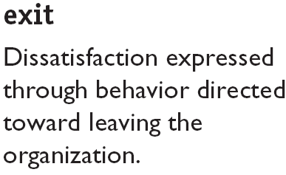
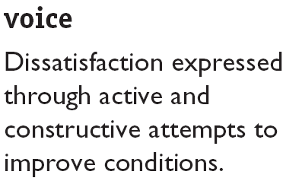
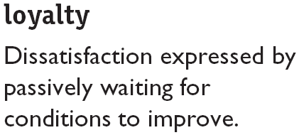
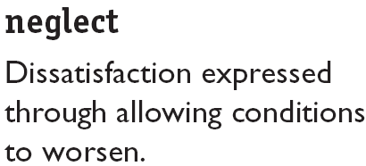
How Employees Can Express Dissatisfaction

Slide 20
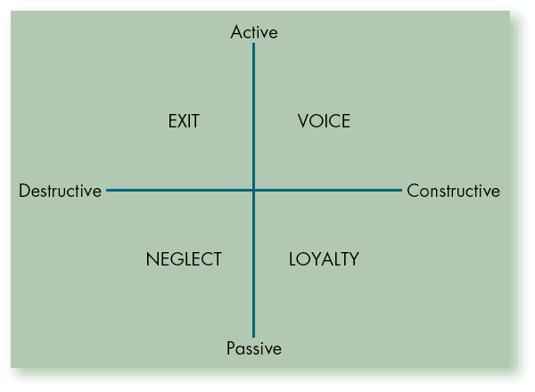
Responses to Job Dissatisfaction

